Slide 1
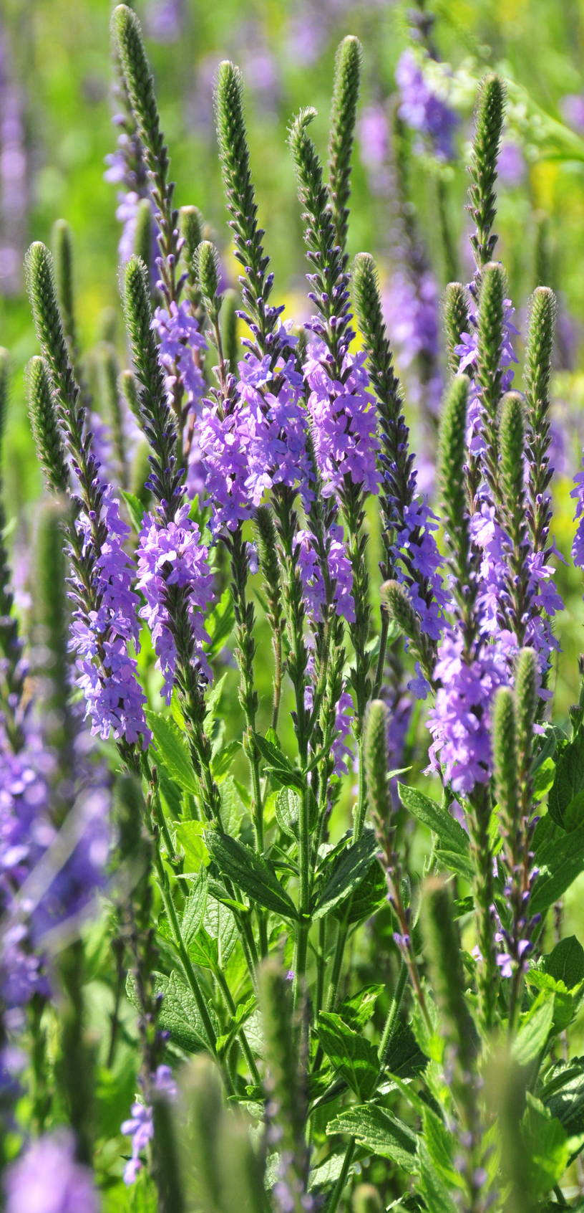
WILD PLANTS EDIBILITY PREDICTION
Team AI Vikings

Slide 2


Himanshi Tiwari
19BCE10013
Misha Sharma
18BCE10332
GROUP MEMBERS
Purushottam Mathur
19BEE0299
Nishant Budia
18BEC0923
Anvesh Audichya
18BEE10050

Slide 3
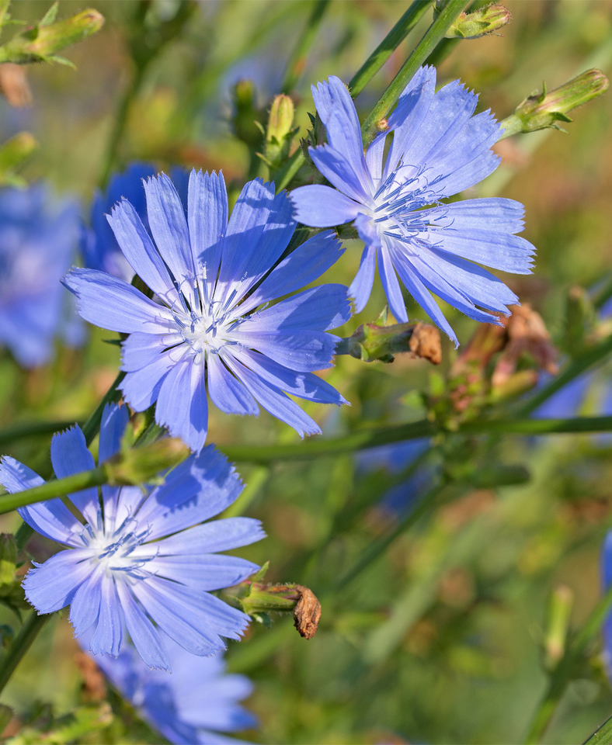
INTRODUCTION
The rural communities of developing countries depend on wild edible plants to meet their food requirements during periods of food shortage. Wild edible plants are mostly serving as supplementary foods in different parts of the world because they are nutritionally rich and can supplement especially vitamins and micro nutrients. The main objective of this project is to build Convolutional neural networks are a deep model to detect and classify the edibility of the wild plant. The model also suggests the effects of non-edible wild plant produce.

Slide 4
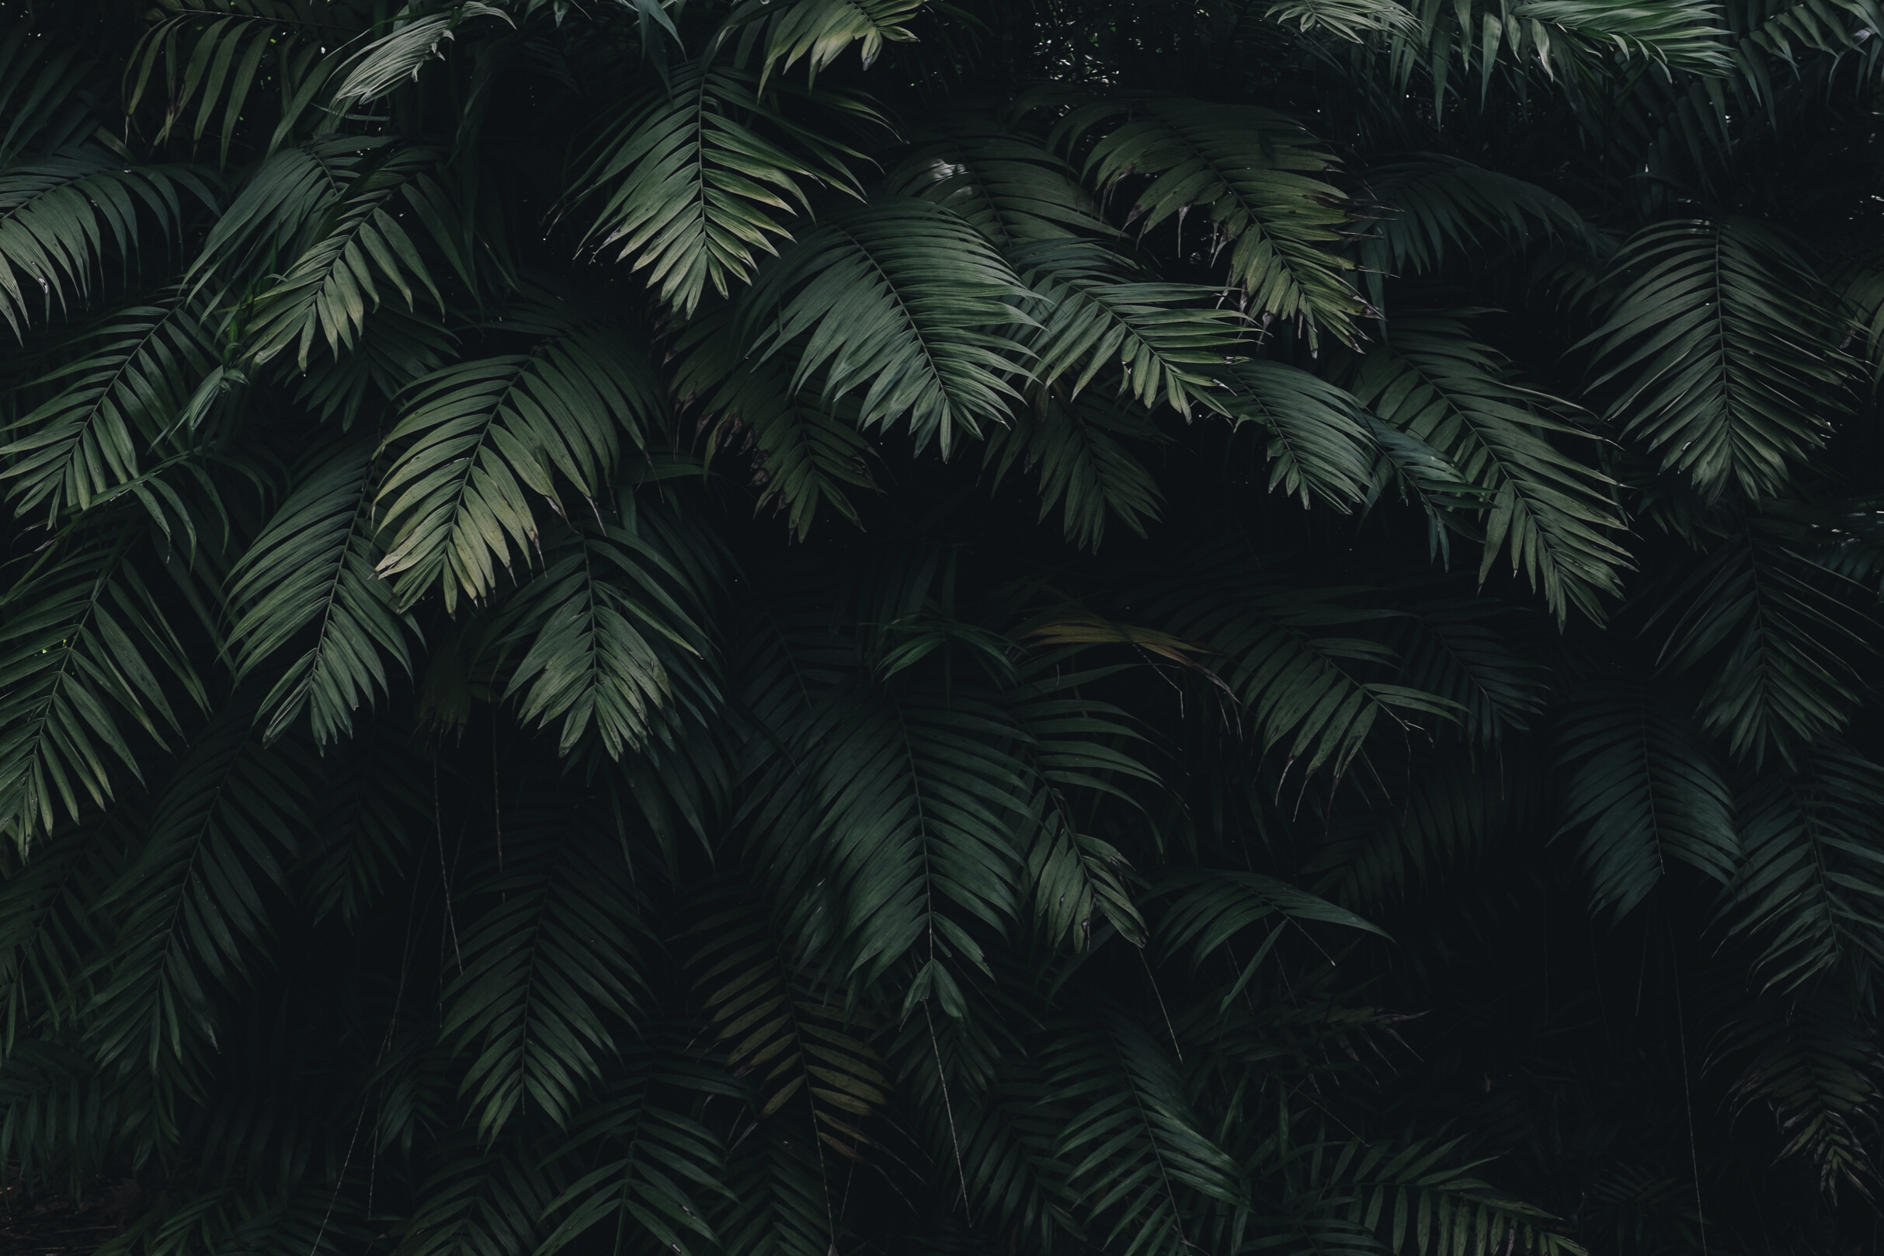
PROBLEM STATEMENT
To determine whether a wild plant is edible or not and determine its species using only a picture of it.

Slide 5
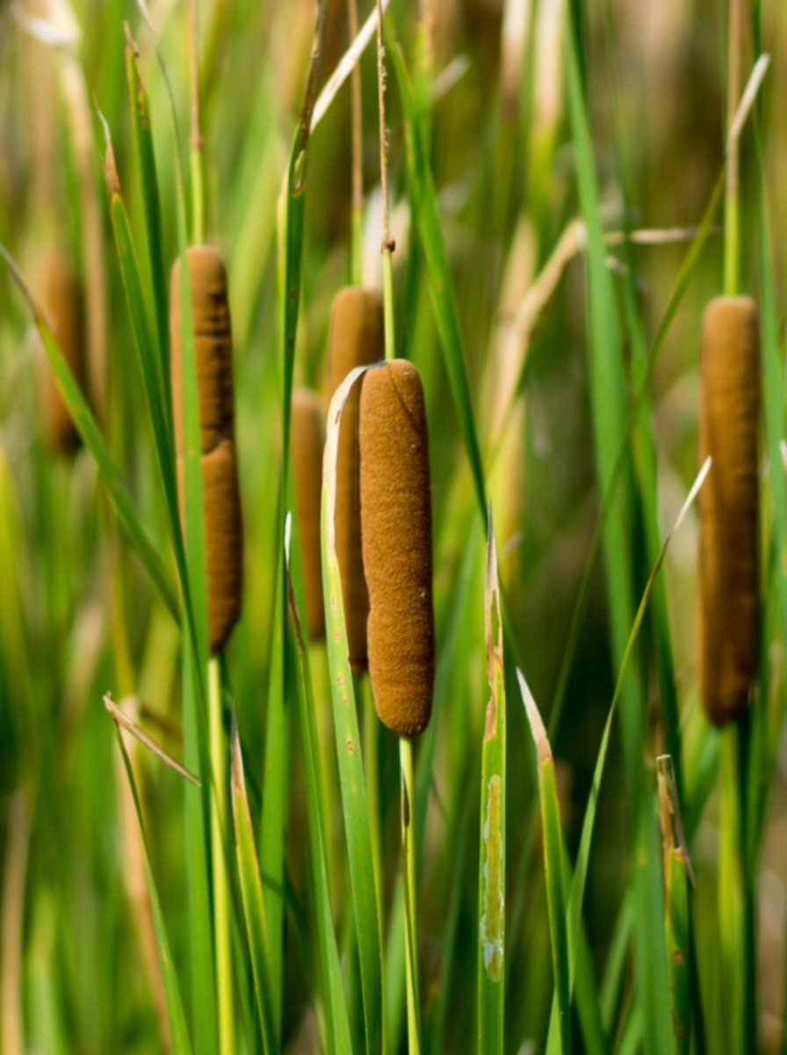
SOLUTION
We created a Flask application where the user selects the image which is to be classified. The image is fed into the model that is trained and the predicted class will be displayed on the webpage using Convolution Neural Networks (CNN).

Slide 6




Anaconda Navigator
Python
SOFTWARE,PACKAGES AND LANGUAGE USED
Spyder
Html, CSS and Javascript
Jupyter Notebook
Flask
TensorFlow
Keras

Slide 7
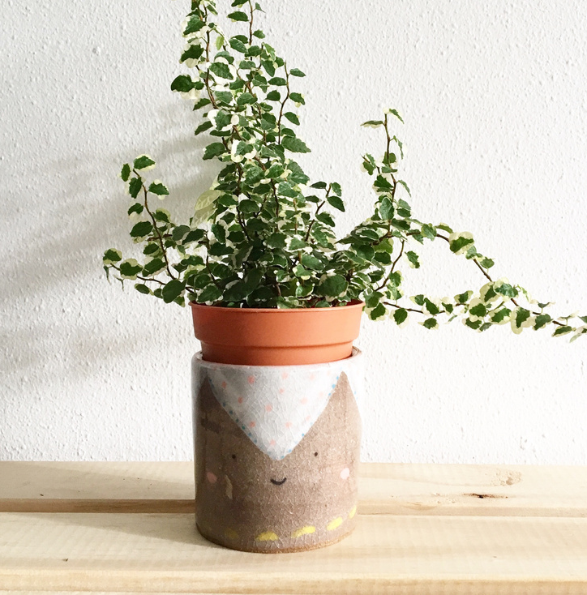
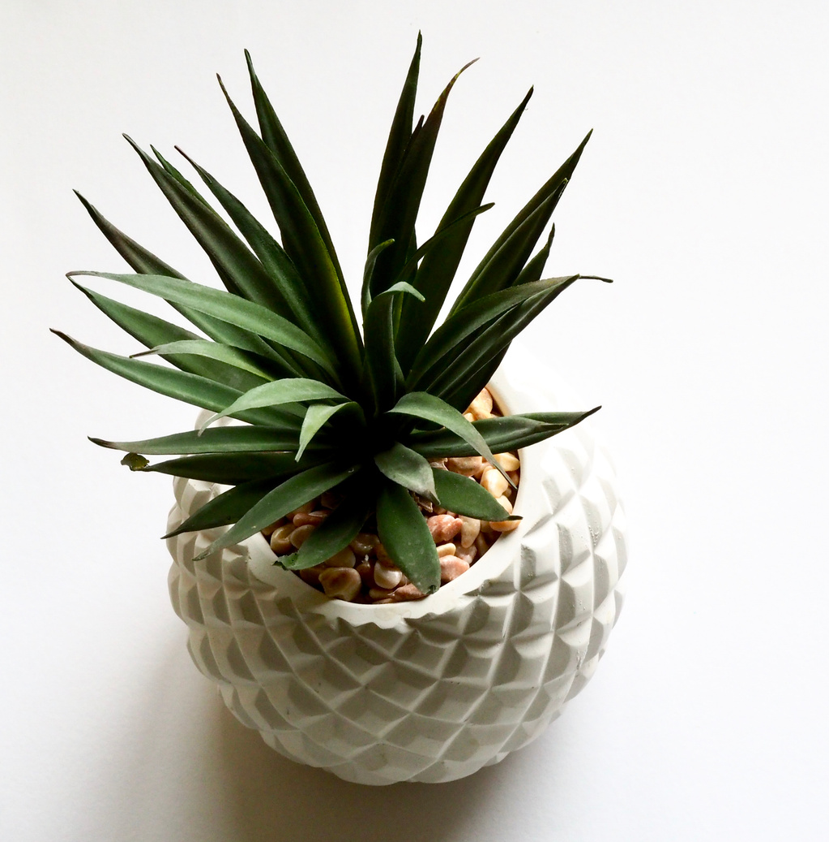

METHODOLOGY
Project Workflow:
User interacts with User interface to upload image
Uploaded image is analysed by the model which is integrated
Once model analyses the uploaded image, the prediction is showcased on the UI

Slide 8
To accomplish this, we completed all the activities and tasks listed below.
Data Collection:
We collected the given dataset from Project Workspace.
Data Preprocessing:
It was done by using the ImageDataGenerator library.
Model Building:
We built the model using required libraries and worked on the accuracy to give correct predictions.
Application Building:
We built the application using HTML, CSS and Javascript. Flask was used as the server to launch the application.

Slide 9
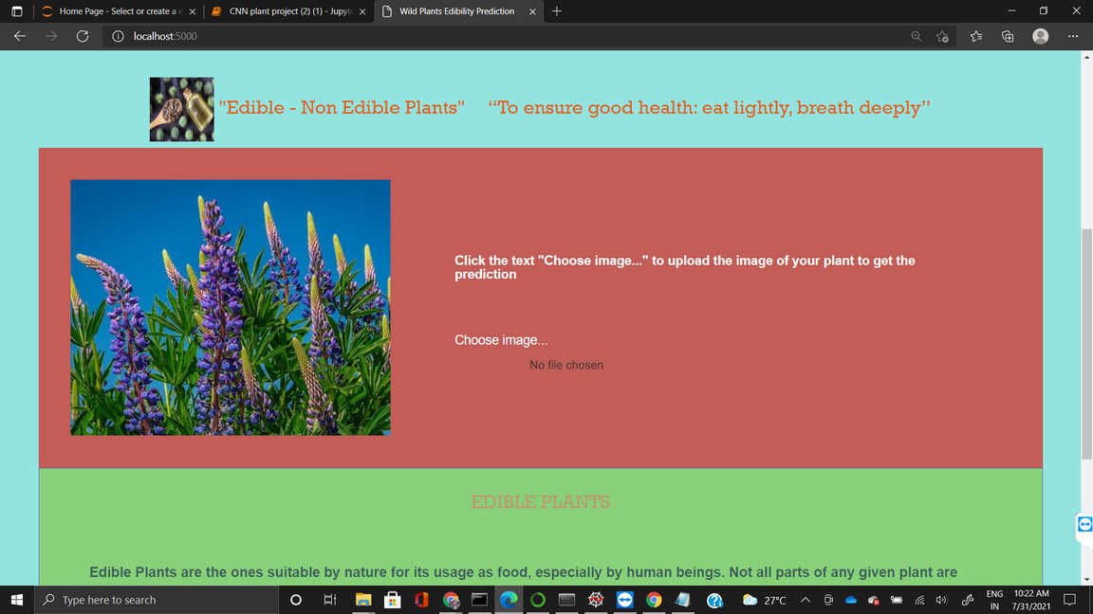
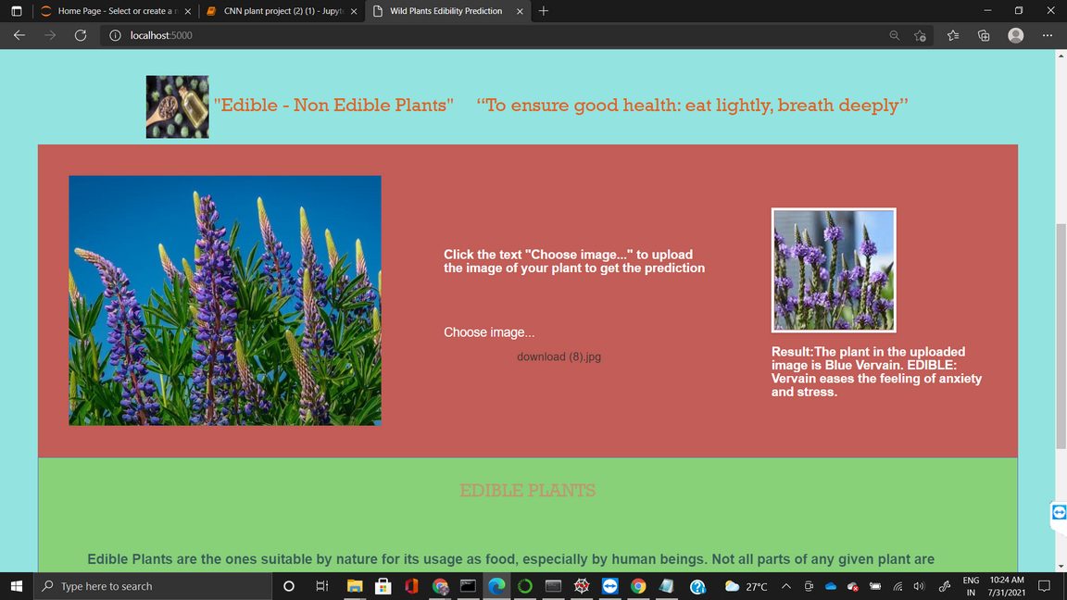
IMPLEMENTATION

Slide 10
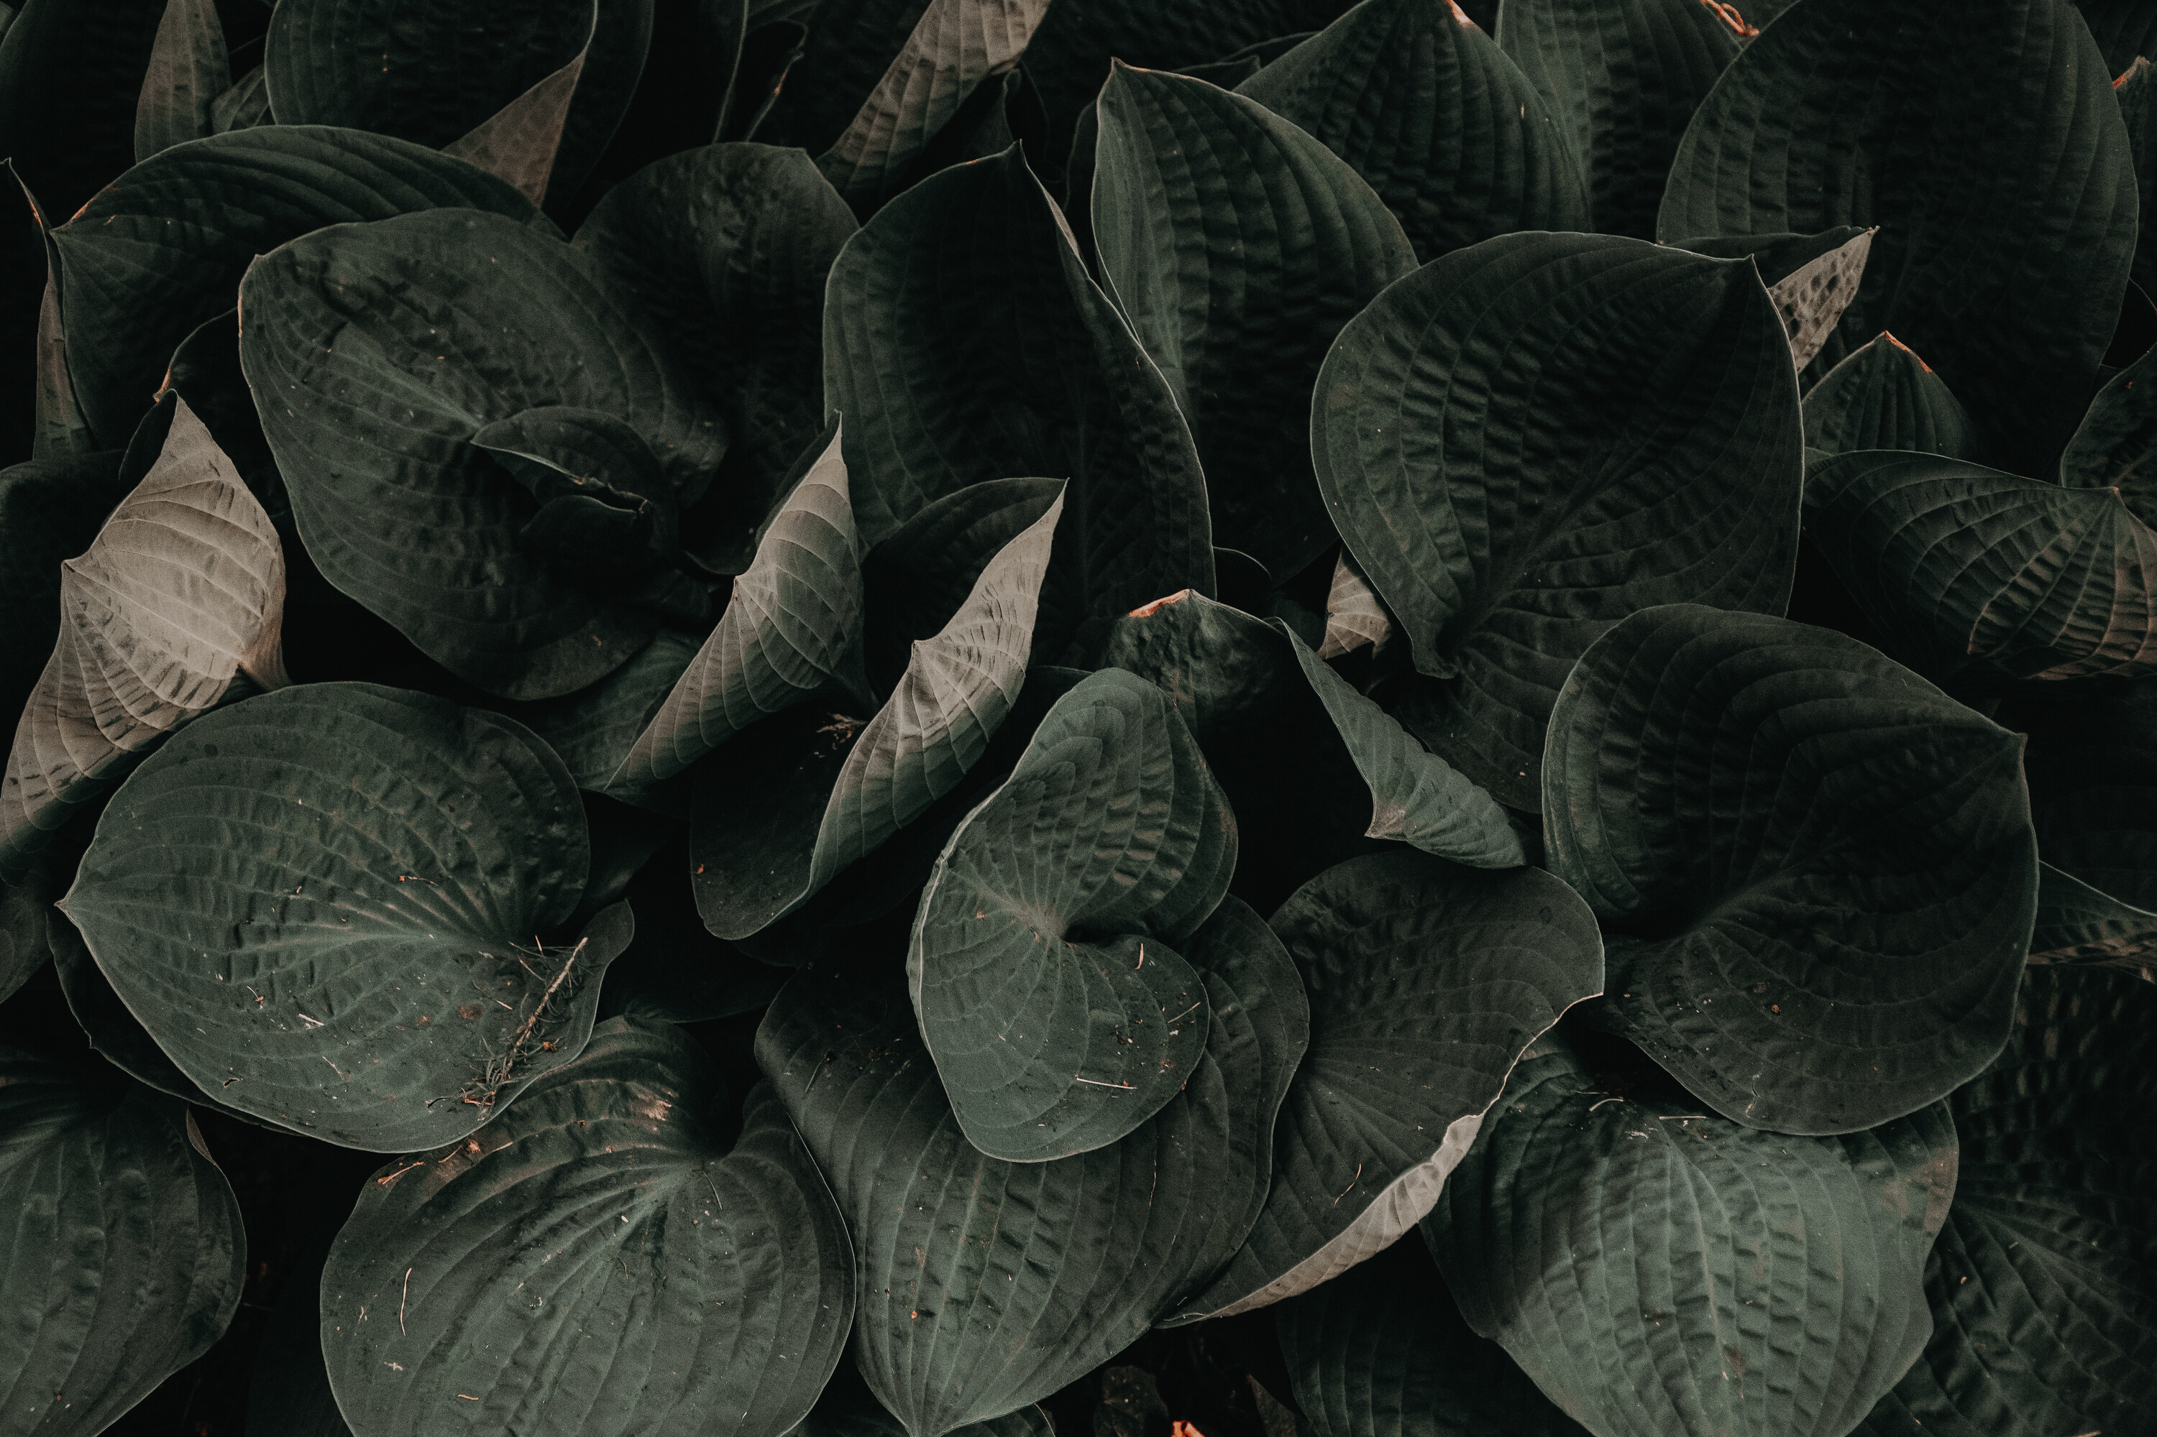
CONCLUSION
The project works sufficiently well in predicting the edibility of an image of a wild plant uploaded to it. The use of Convolutional neural networks greatly helps the use case as predicted. The website created is intuitive to use, simple to understand and fast in its response. It provides ample knowledge of the plant picture uploaded to it.
The prediction and classification of wilds plants and their edibility is a powerful source to have for many use cases, for example, for adventurists to travel to remote areas with limited sources of food, for people living in villages where a staple source of food is wild plants.

Slide 11
THANK YOU
Pradeepthi mam's guidance is really appreciated. It helped us to create and complete this project successfully. ​

